Slide 1
Six Sigma Brief & FAQ
Tony Zheng-a17135

Slide 2
CDC Governance
EMS MBB
PCR BB
CDC SEPG
CDC 6σ Committee
Tao ZHENG
CDC GB pool, Managers, SMEs
SSPI Proposal 4
SSPD Proposal 3
SSPI Proposal 1
SSPI Proposal 3
SSPD Proposal 2
SSPI Proposal 1
SSPI Proposal 2
SSPD Proposal 1**
SSPI Proposal 1
**:
For SSPD, it is based on each case one by one. And basically, it’s group decision by engineering managers, MBB, Architects. For detail, please check CIC4000.

Slide 3
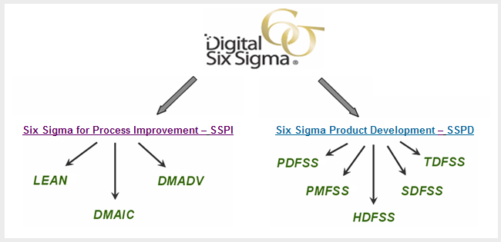
Motorola’s Digital Six Sigma Program
Notes:
Red = Deployed, Green = Current Initiatives, Gray = Future Initiative

Slide 4
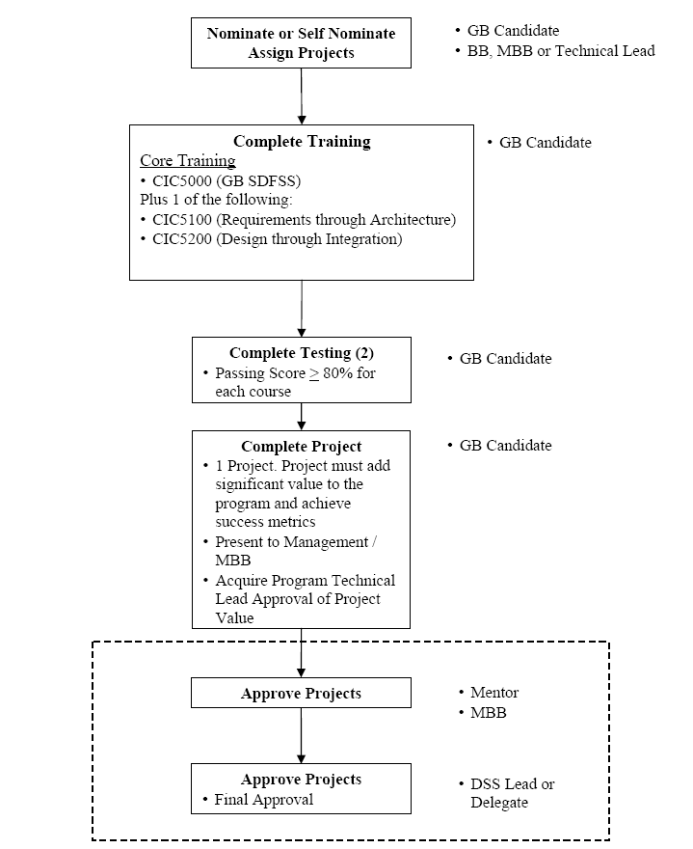
SSPD (DFSS)-GB Certification Procedure
CIC5000, CIC5100 and CIC5200 Phase Out

Slide 5
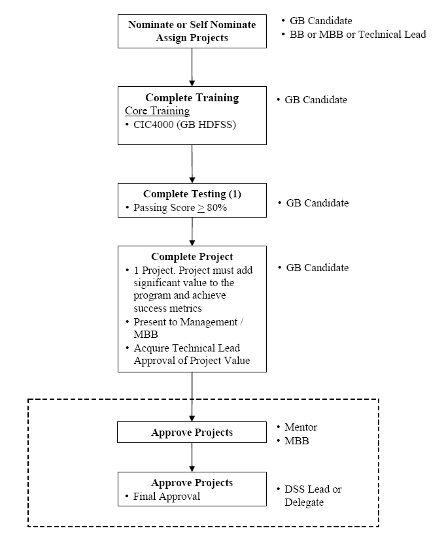
SSPD(DFSS)-GB Certification Procedure
CIC4000 is the mandatory training
Course for DFSS

Slide 6
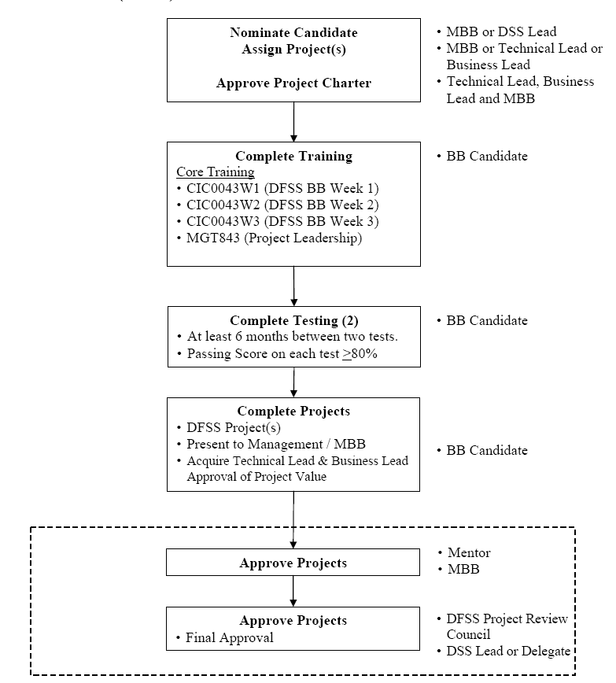
SSPD(DFSS)-BB Certification Procedure

Slide 7
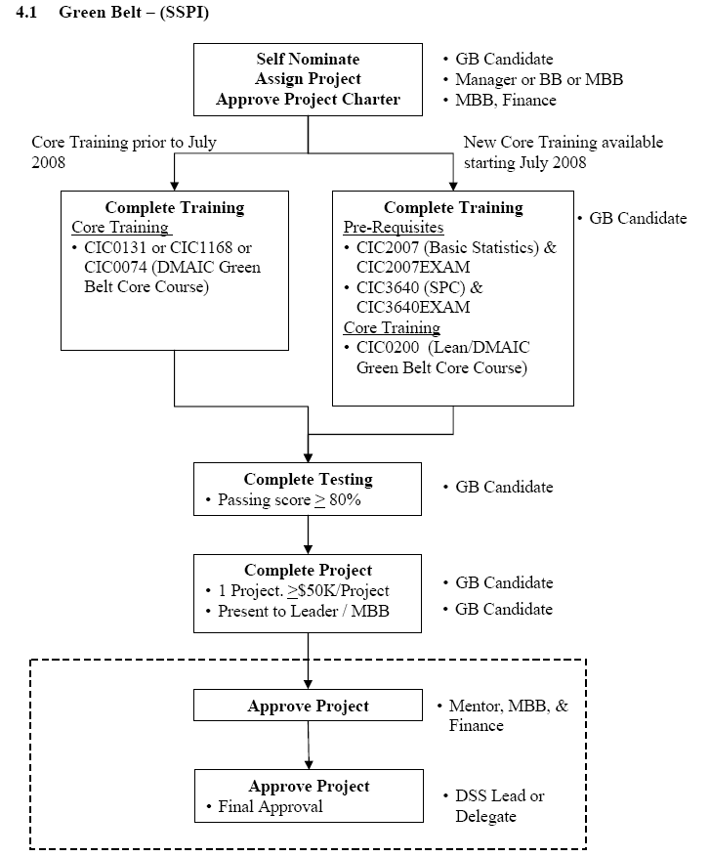
SSPI(DSS)-GB Certification Procedure
Candidate registering
http://qualityiq.mot.com/qcrsmenu.aspx
BB Mentor search
Search BB or MBB
http://qualityiq.mot.com/search.aspx
Find Finance Rep
http://qualityiq.mot.com/qcrscontacts.aspx by Sector and by default Randy Swenson is for
CDC DSS project
So far, only CIC0200 is 5 day instructor-led
class room training while all the others are on-
line.
On-Line
5 days instructor-led

Slide 8
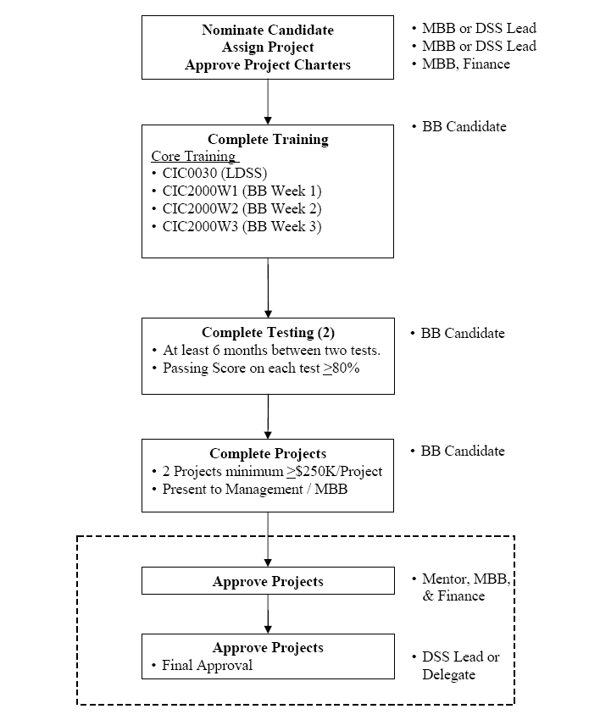
SSPI(DSS)-BB Certification Procedure
Candidate registering (Must MBB nominate, not self registering)
http://qualityiq.mot.com/qcrsmenu.aspx
BB Mentor search
Search BB or MBB
http://qualityiq.mot.com/search.aspx
Find Finance Rep
http://qualityiq.mot.com/qcrscontacts.aspx by Sector and by default Randy Swenson is for
CDC DSS project

Slide 9
FAQ
1. If I want to run a DSS GB project, how can I do?
Firstly, check with your supervisor to identify if the process improvement opportunity is valid to support scorecard goal and then generate a proposal for the potential project. Pass team internal review firstly and then inform CDC six sigma champion (Tony ZHENG-a17135) for proposal re-visit to decide the next step.
2. If I want to run a DFSS GB project, how can I do?
Firstly, DFSS project is program alignment activity by default and need to follow program planning. Basically, each program which plan to run DFSS have an assigned BB candidate and BB mentor assigned in the program, the GB candidate need to get one CP assigned to him or her (not KPI) and also finish the training per the certification procedure slides above. During whole project life cycle, the CP owner/belt candidate need to work with BB candidate and BB mentor to finish the CPM path.
3. Where can I get the six sigma related information
All the related information can be got via http://dss.mot.com
Such as certification policy: http://compass.mot.com/go/dss.cert.policy/
4. Where can I get support for six sigma related topic
Firstly, you can check with your project SQE for first time Q&A.
Either SQE or you can send email to Tony Zheng-a17135 or drop a call 2280 for some specific questions

